Slide 1
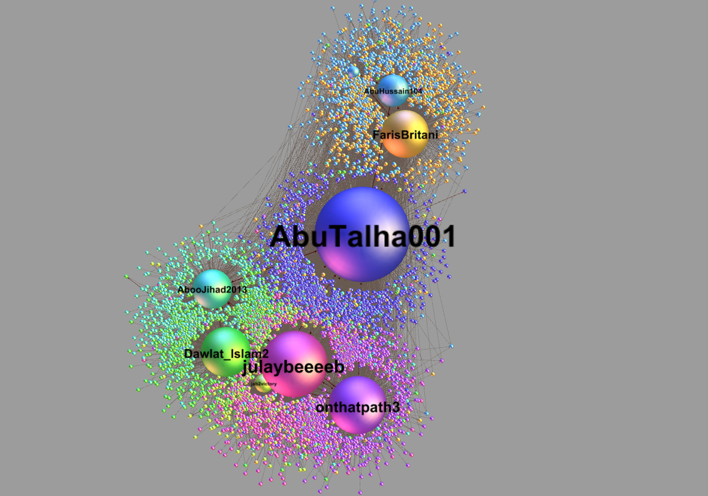

Slide 2
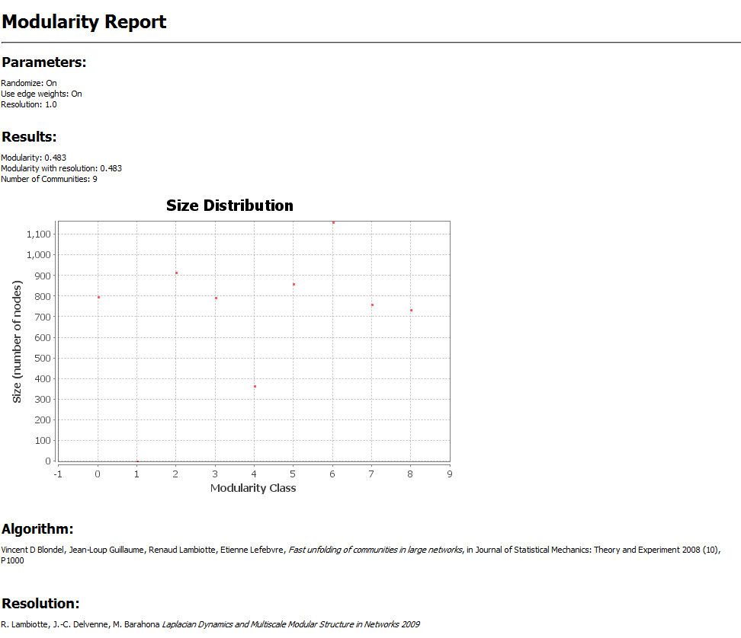

Slide 3
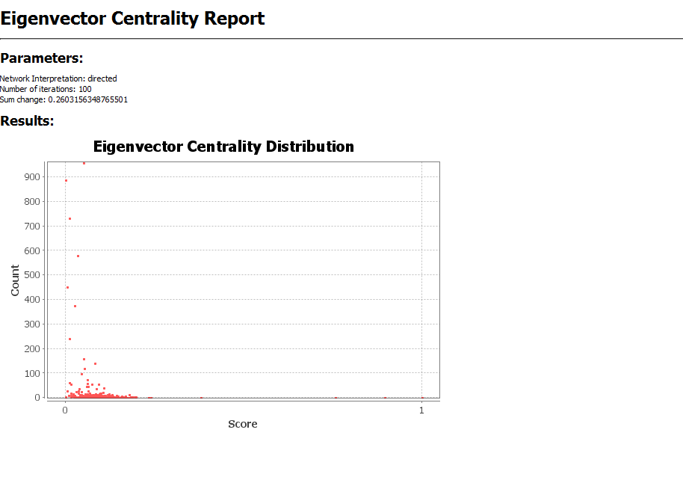

Slide 4
*Chart reflects 2700 tweets of 13080 collected
Nine Accounts

Slide 5
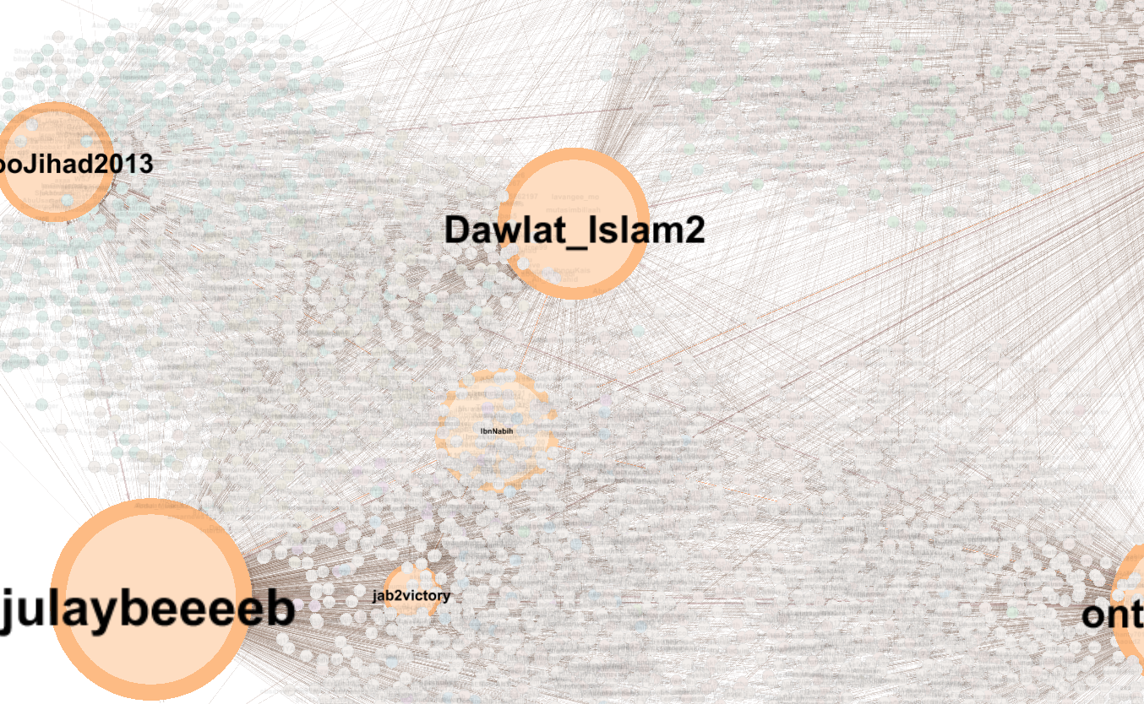

Slide 6
